Slide 1

Data bootcamp project: Understanding & predicting investors behaviour using data science
September 7th 2020
Rémi Maillon

Slide 2

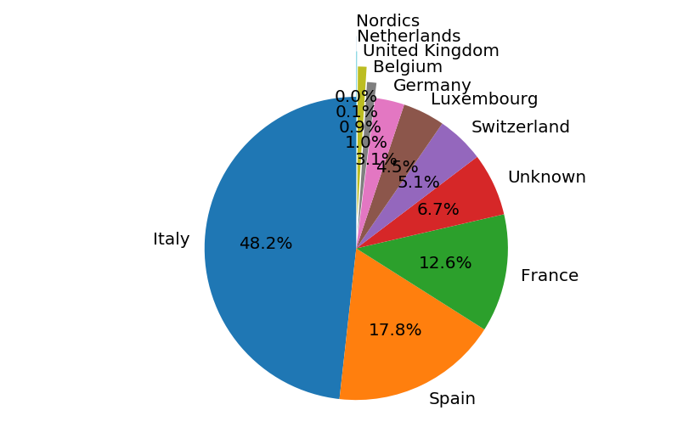
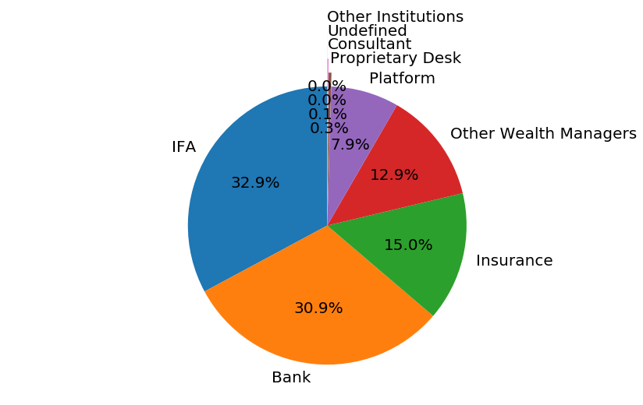
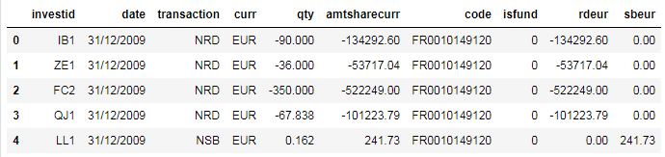
Dataset overview
Fund A at Dec. 31st 2009
Financial transaction history from 6 investment funds in different currencies (EUR, USD, CHF, GBP).
History of financial transactions spanning from December 31st 2009 to June 29th 2020 including a total of 520,463 transactions.
Dataset split across 4 tables: Flows, Holding, Navs and Investors.
757 investors of different type (banks, insurance, IFA,…) and country (Italy, Spain, France, Switzerland,…).
Fund share / benchmark price history
Target variable
Overview of « flows » table with Pandas

Slide 3
Problem definition
Predict investors’ behaviour in terms of buying / selling fund share quantities.
Target variable: fund share quantity at future time.
Features: past quantities, share & benchmark prices (at present or past).
Assess impact of external economic parameters such as stock market index, interest and currency rates, inflation,… in order to understand investors’ behaviour.
Prediction can be attempted at different time scales: same day, next day, next week, next month,…

Slide 4
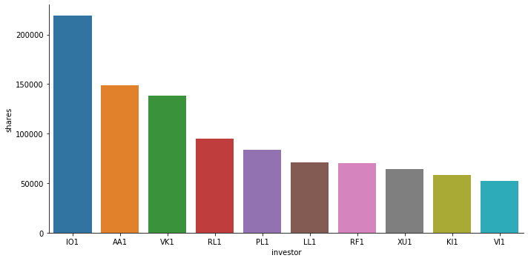
Top investor ranking at Dec 31st 2009
Number of shares held by investors in fund A at Dec 31st 2009
Top Investor IO1 accounts for 9.9% of total number of shares as of Dec 31st 2009

Slide 5
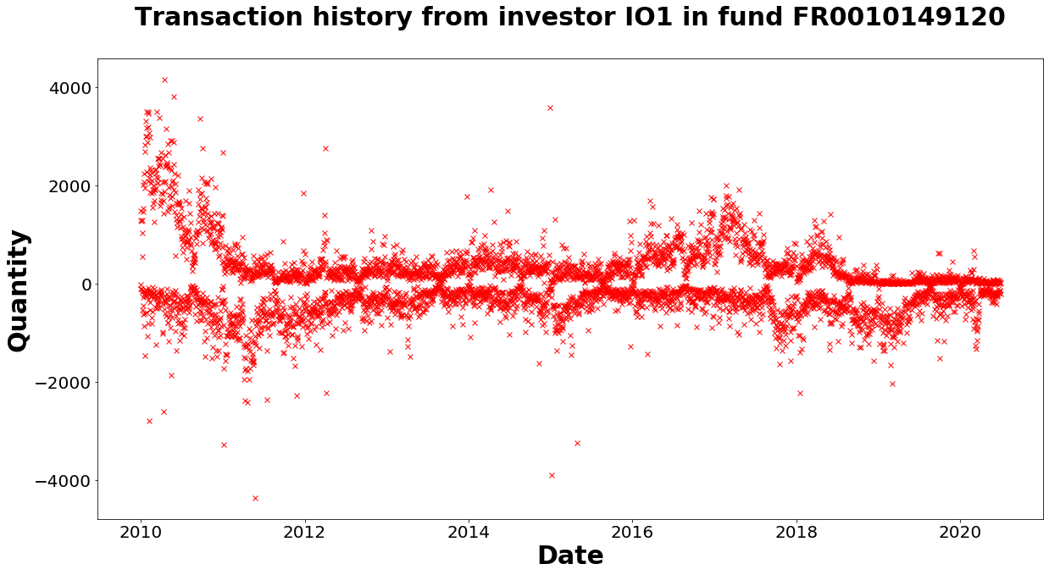
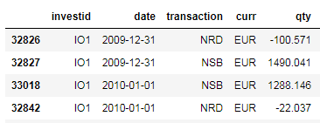
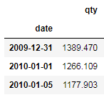
Transaction history for top investor IO1
Sum

Slide 6
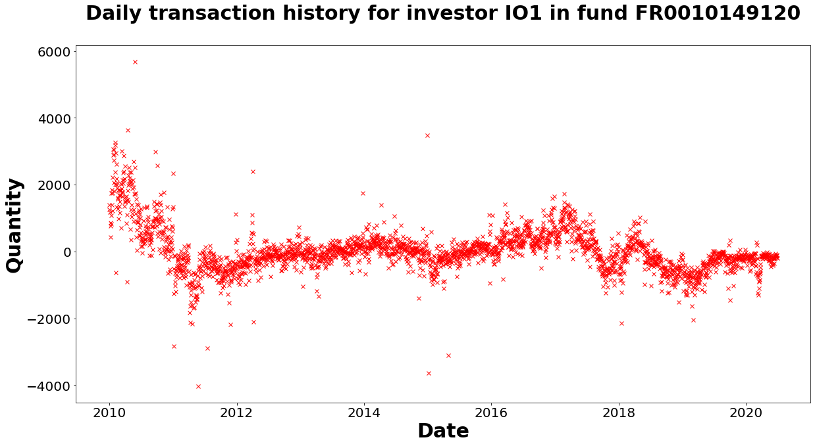
Group/sum IO1 transactions on a daily basis
Training history
Training history
Prediction (next day)
Prediction (next day)

Slide 7
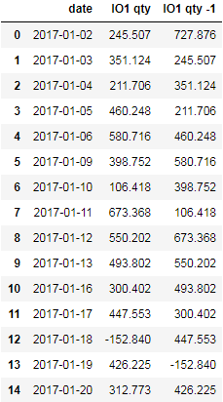
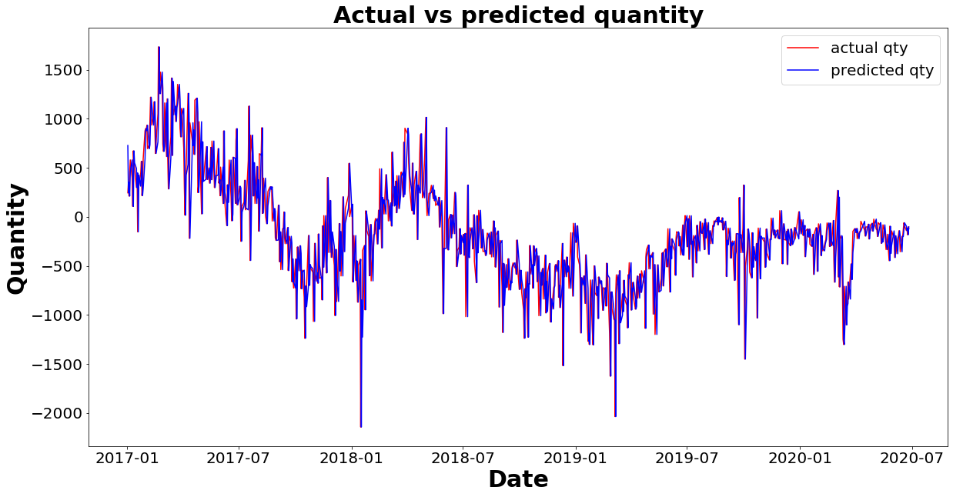
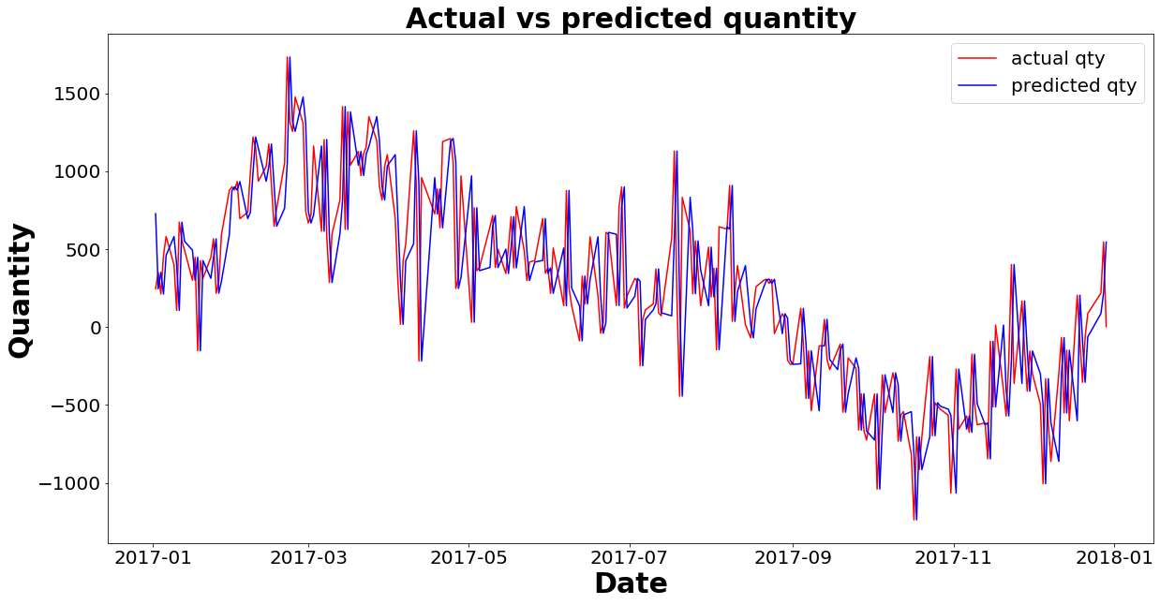
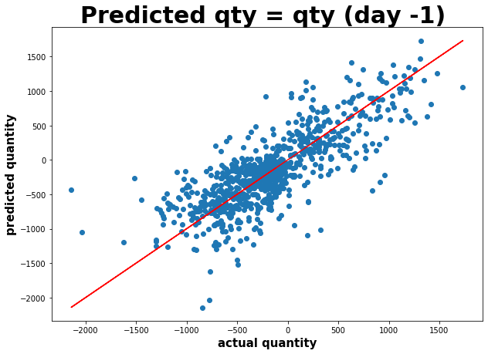
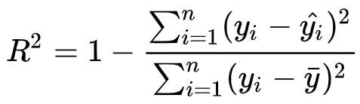
Dummy case 1: predicted qty = qty at day -1
R2 = 0.57

Slide 8
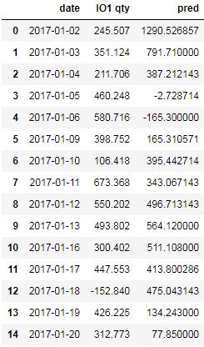
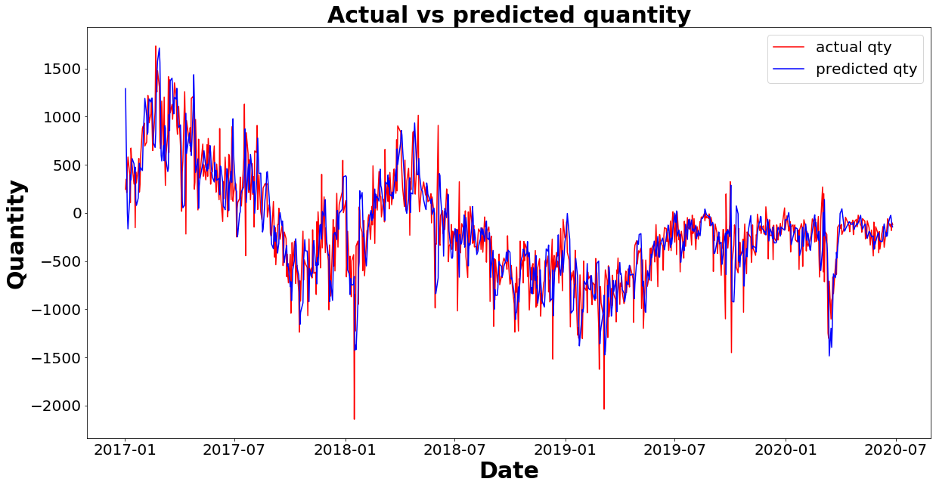
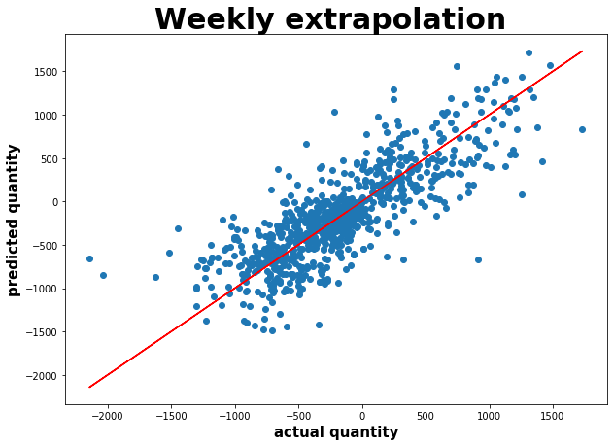
Dummy case 2: weekly linear extrapolation of qty
R2 = 0.61

Slide 9
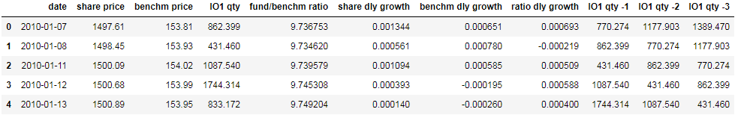
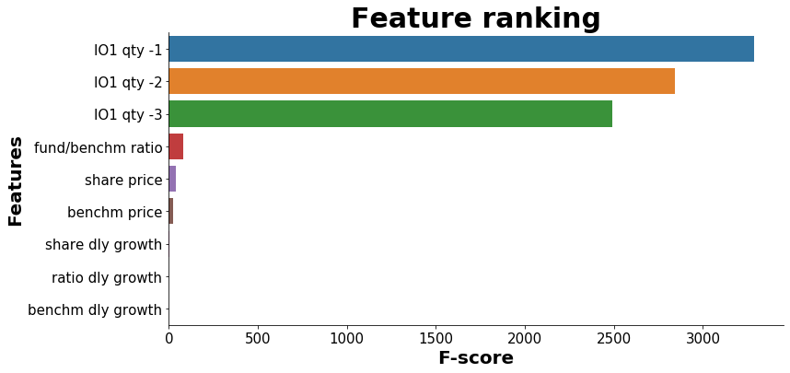
Linear regression with other variables
Same day prediction of quantity assuming the following data is known:
Share price (opening)
Benchmark price (opening)

Slide 10
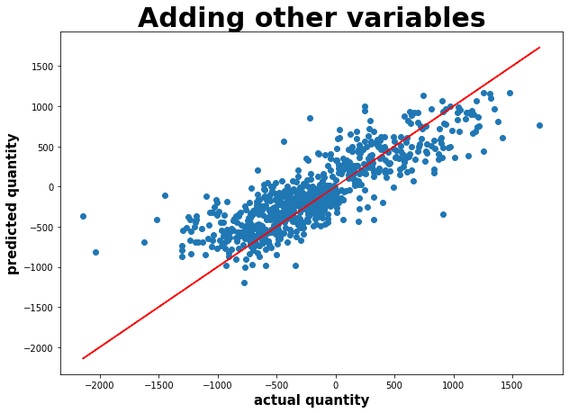
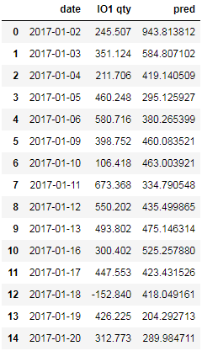
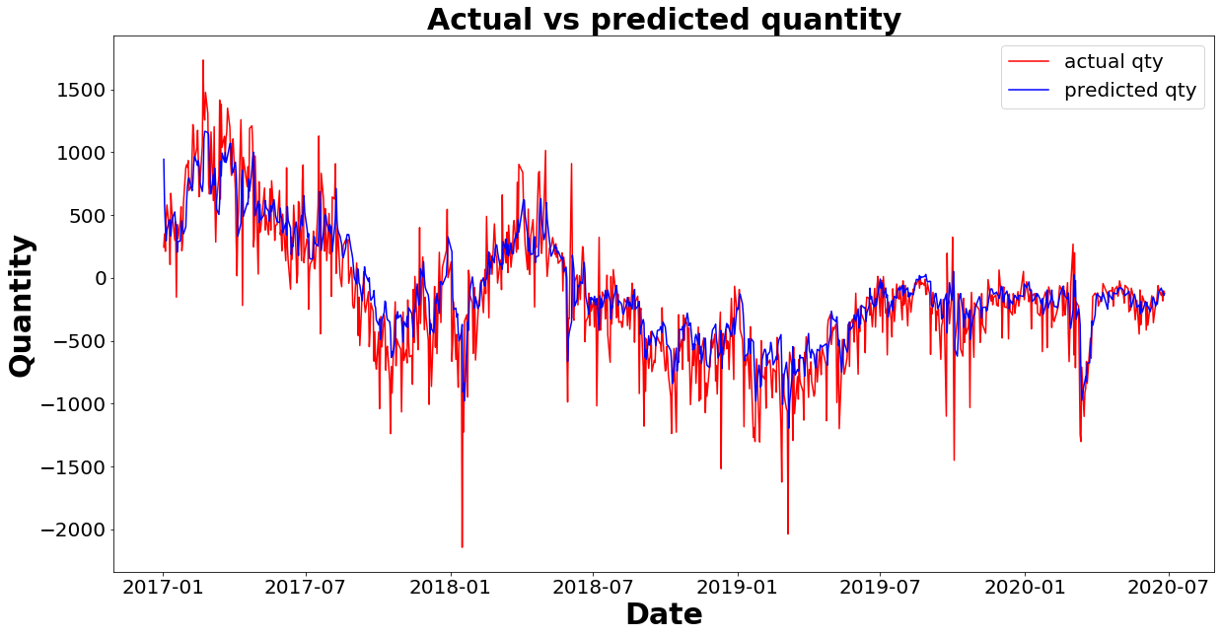
Linear regression with other variables
R2 = 0.68

Slide 11
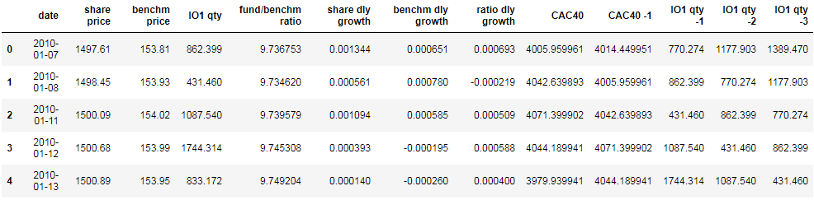
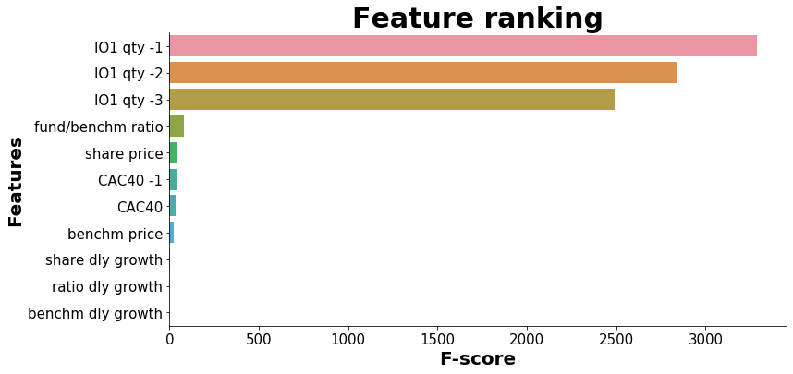
Linear regression adding external variables
Add CAC 40 at day & day -1 as external variables to the training dataset

Slide 12
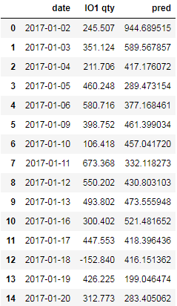
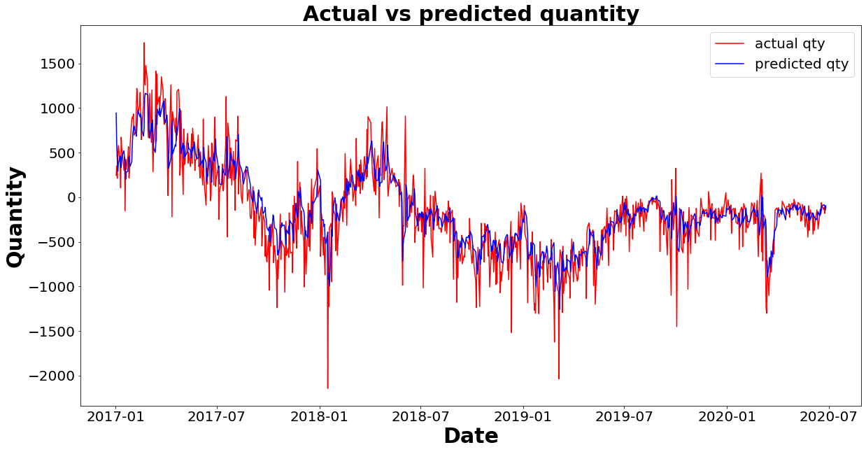
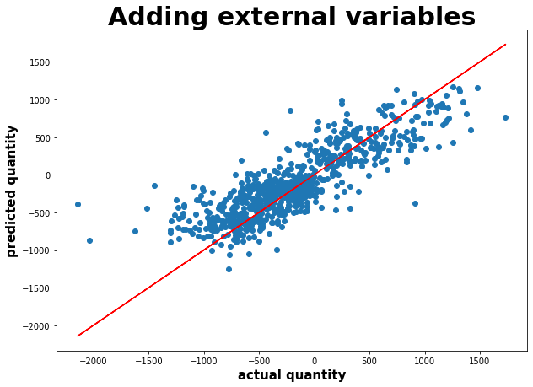
Linear regression adding external variables
R2 = 0.69

Slide 13
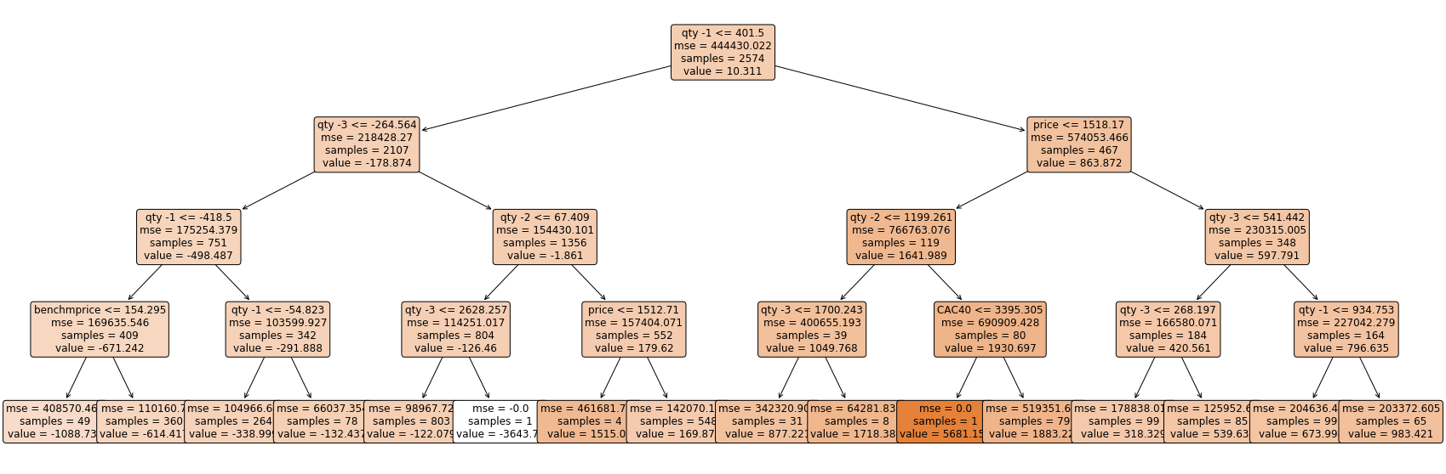
Decision tree (depth = 4)

Slide 14
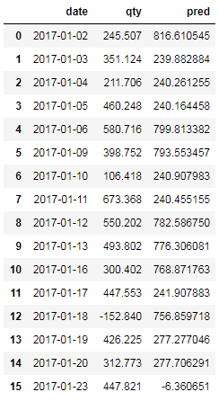
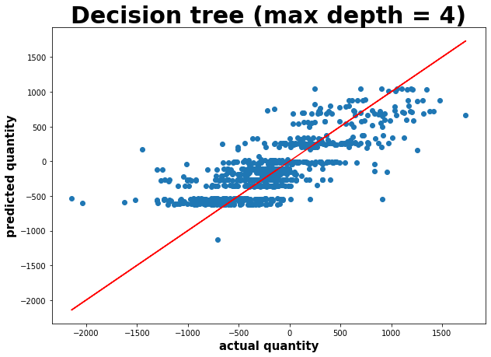
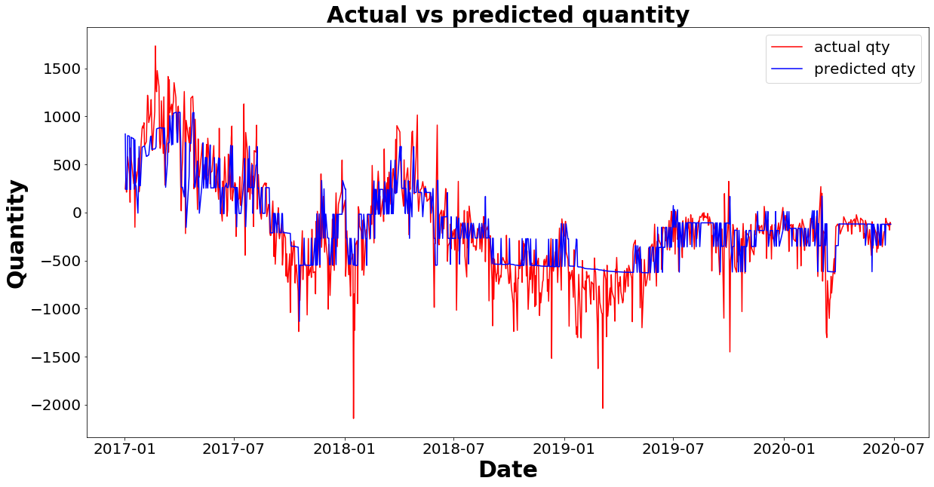
Decision tree (depth = 4)
R2 = 0.61

Slide 15
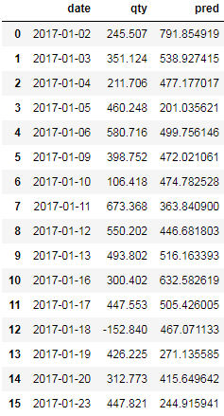

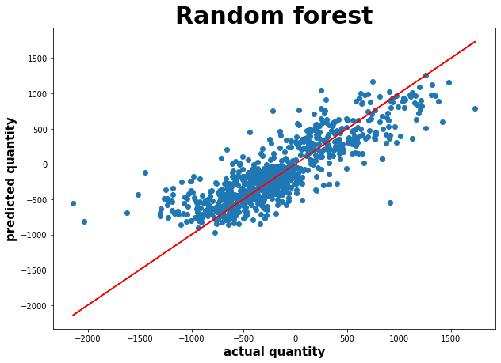
Random forest (est = 500, dpth = 6, samples =500 )
R2 = 0.69

Slide 16
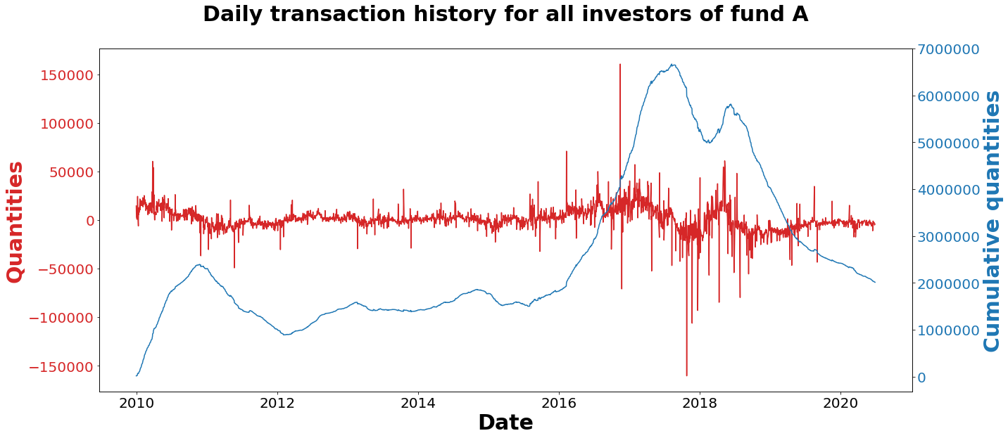
Predicting behavior of all investors of Fund A
Negative
trend

Slide 17
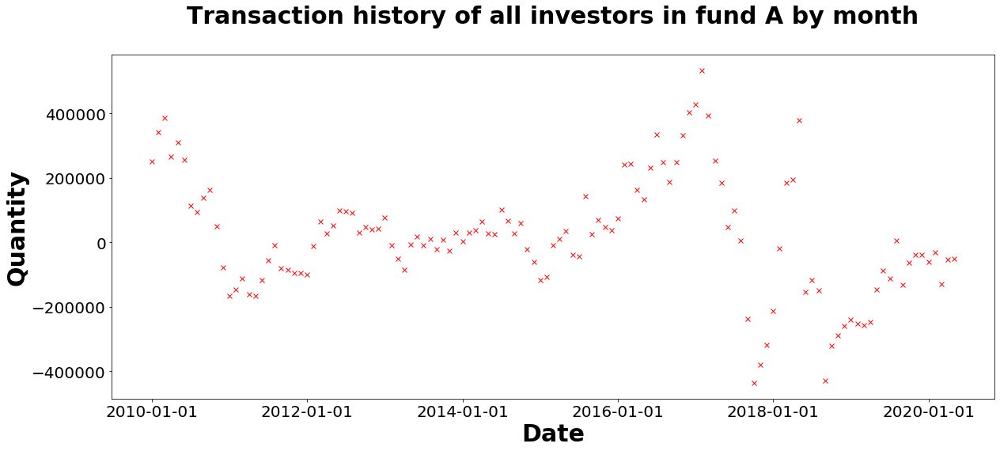
Summing quantities in fund A for each month
Prediction (next month)
Training history
Training history
Prediction (next month)

Slide 18
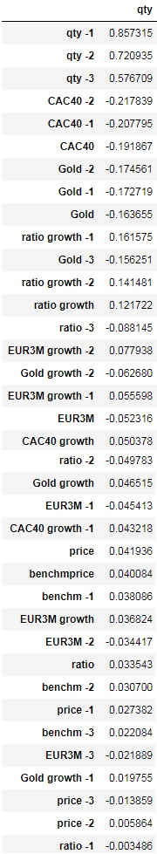
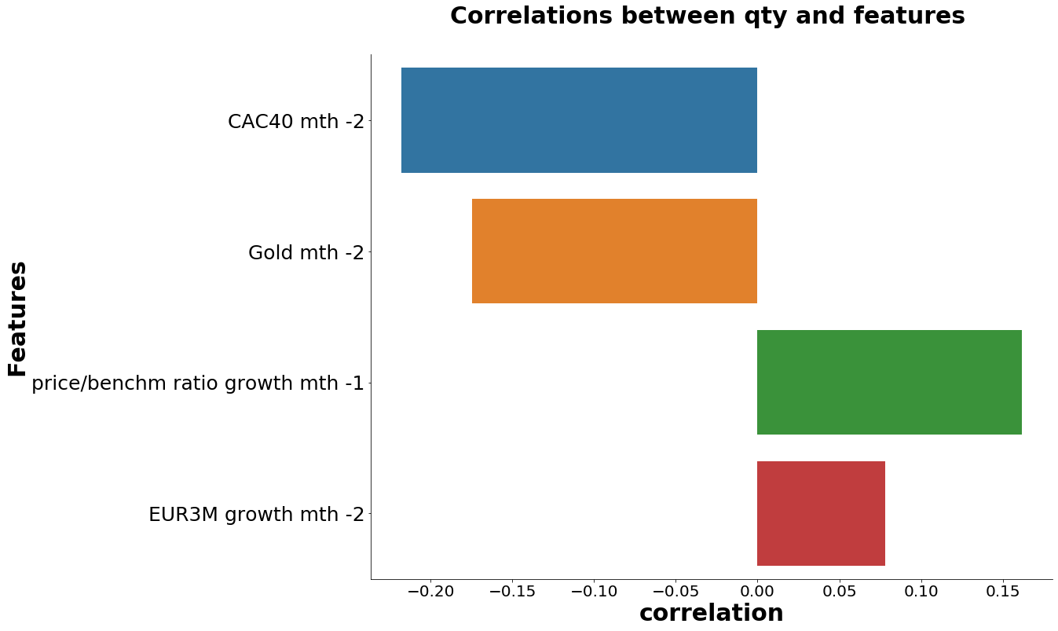
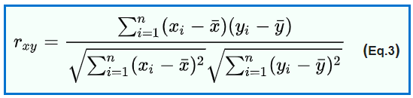
Correlations between quantity & features
April 2010 – May 2020
37 features

Slide 19
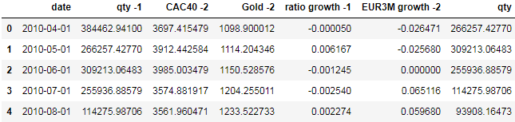
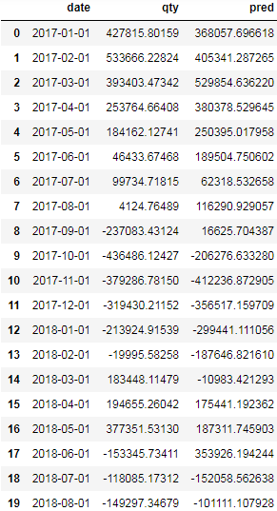
Monthly prediction using linear regression
Features
Target variable
Prediction of quantity over next month based on following features:
Last month quantity
CAC40 average value at month -2
Gold average value at month -2
Share / benchmark ratio growth rate between month -2 and month -1
Euribor 3M growth rate between month -3 and month -2.

Slide 20
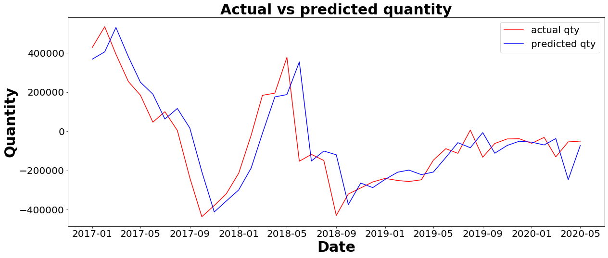
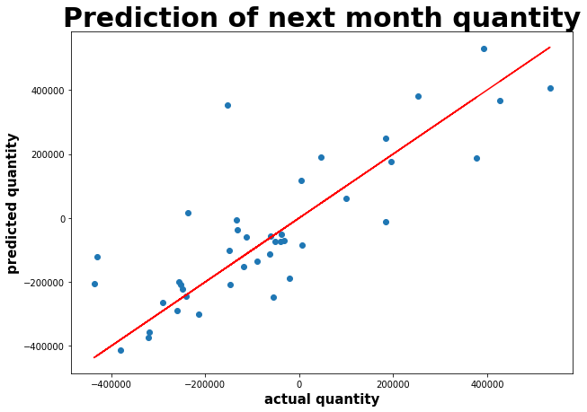
Monthly prediction using linear regression
R2 = 0.64

Slide 21
Conclusion & way forward
R2 score of 69% could be achieved on same day prediction of quantity from January 2017 using both multivariate linear regression and random forest.
The quantity of shares is inversely correlated with the CAC40 and the gold prices and directly correlated with the performance of the fund with respect to the benchmark and the Euribor.
Keep testing different combination of features
Apply algorithm on different funds.
Test prediction with XG boost.
Test prediction using recurrent neural networks such as LSTM.

Slide 22

Thank you!

